Slide 1


Confidential
YAMAHA MOTOR SOLUTIONS CO., LTD
Permitted Users YMSL Group Only
CONFIRMATION PRESENTATION
Sanket Kumar
YNA Team
1st September 2021

Slide 2


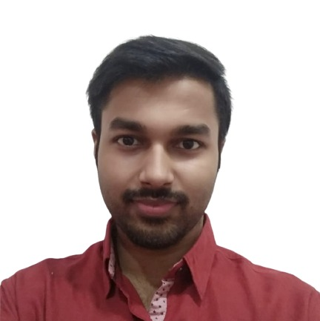



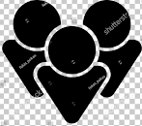
INTRODUCTION
EDUCATION
Bachelor Of Technology(CSE)
Kalinga Institute of Industrial Technology Bhubaneswar , Odisha
OBJECTIVE
A believer of excellence, having the zeal to up-skill, being efficient & productive for the company & develop as well as diversify my professional skill-set.
SKILL SET
Languages : Java, C++, C
Framework / API : Spring Boot, ReactJS, NodeJS
Database: MySQL
HOBBIES
Sports
Music
Travelling
CONTACT
8406000322
YNA TEAM
SANKET KUMAR
Software Engineer Trainee

Slide 3


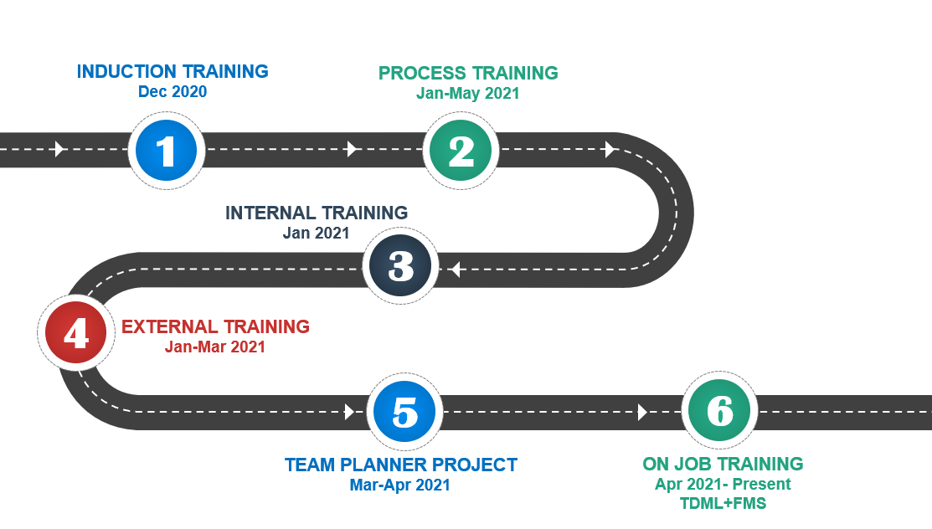




JOURNEY AT YMSLI
PROJECT REVNEUE TRACKER
Mar-Jul 2021

Slide 4
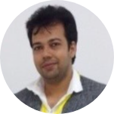
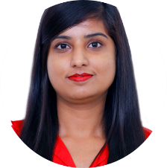
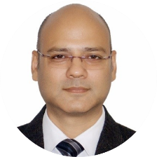

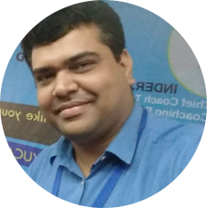





INDUCTION TRAININGS
17th Dec 2020 - 21st Dec 2020
17th Dec 2020 - 21st Dec 2020
HR Induction + Japanese Culture
QMS Training
Campus to Corporate Training
IT Helpdesk training
HRIS Training
17th Dec 2020
Surender Singh
17th Dec 2020
Priya Arora
18th Dec 2020
Nagendra Rawat
18th Dec 2020
Sonam Lata
21st Dec 2020
Vir Bharat

Slide 5
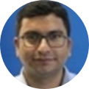
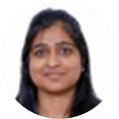








PROCESS TRAININGS
22nd Jan 2021 - 28th May 2021
URS Document Training
Effort Estimation Training
Testing Training
Incident + Service + Problem Management
Release Mgt. + Change Request Process
22nd Jan 2021
Manoj Singh
26th Mar 2021
Neha Kalra
23rd Apr 2021
Atul Jain
26th May 2021
Shobhit Bansal
28th May 2021
Megha Bhargava

Slide 6
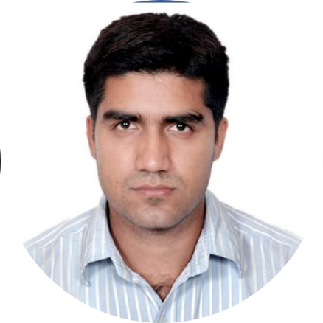

INTERNAL TRAINING
SURENDER KAJLA
(4th Jan 2021 - 22nd Jan 2021)
Basic Java
Concepts
Design
Patterns
Program
Visualization
Software
Engineering
Process
Class Diagram
Importance
of Design
Documents
Object oriented Architecture

Slide 7
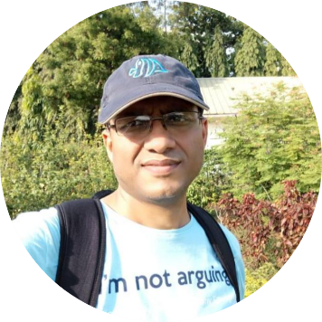
EXTERNAL TRAINING (Java)
RAJEEV GUPTA
( 2nd Jan 2021 - 10th Mar 2021)
Design
Patterns
RDBMS
and SQL
JDBC and
Hibernate
HTML, CSS
and
JavaScript
Spring and
Spring Boot
MongoDB,
Express.js
and Node.js
Core Java

Slide 8
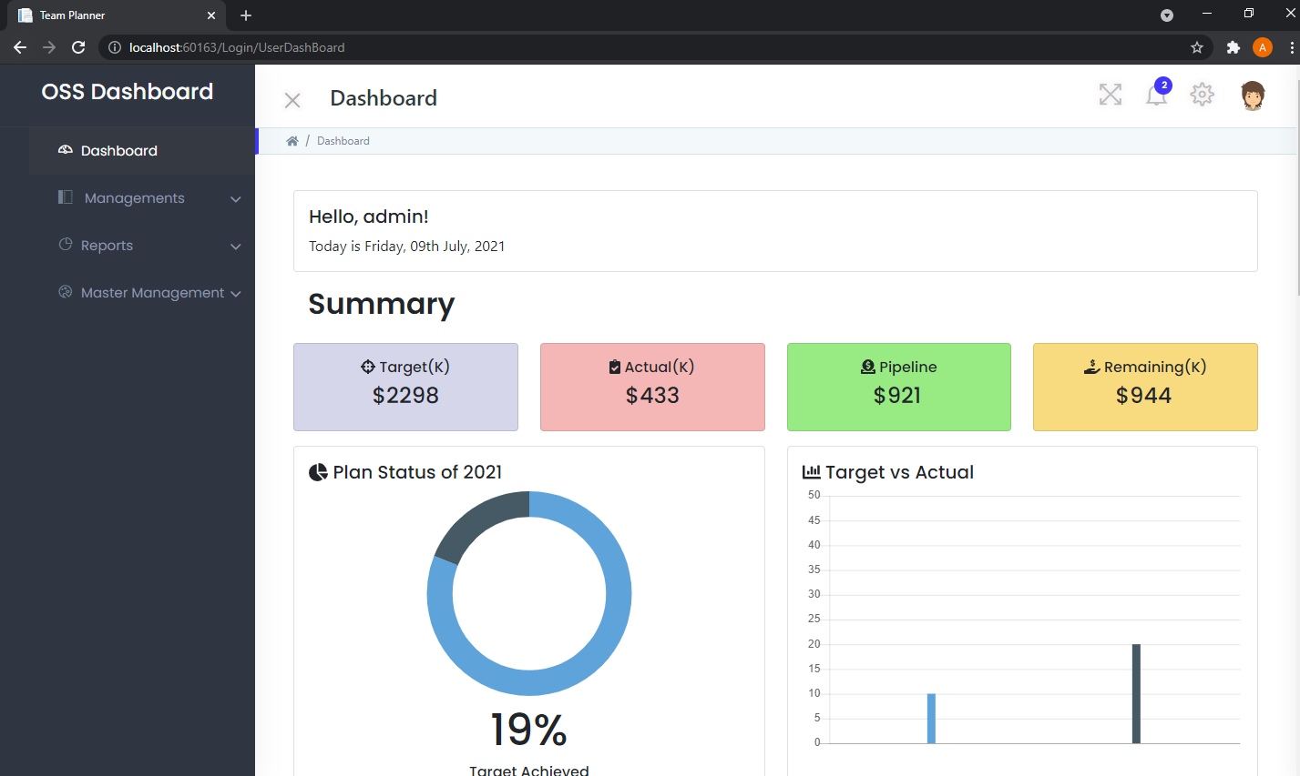


PROJECT REVENUE TRACKER
Mentored by: SURENDER KAJLA (11th Mar 2021 - 21st Jul 2021)
A web-based application to track ongoing projects, revenues and resources of the organization which will help in successfully meeting team goals and objectives.
CONTRIBUTIONS
DOCUMENTATION :
Created User Requirement Specification Document.
Created Test Case Document
Created Class Diagram.
LEARNINGS
Worked on .NET framework, PostgreSQL and Razor Pages.
IMPLEMENTATION :
1. Client Module 2. Project Module
3. Resource Management Module 4. Dashboard Module
Software Design and Documentation.
Collaboration and teamwork.
Enhanced front end development skills.

Slide 9
2DEGREES MOBILE LIMITED (OJT)
TEAM: TDML (12th Apr 2021 - Present)
CONTRIBUTIONS
LEARNINGS
Hands on Experience on applications like SOAP-UI, Super-PuTTY and WinSCP.
Working on SQL Developer and enhanced SQL skills.
Learned basic Linux commands and XQuery.
Overview of ESB and proxy services.
Learned to effectively debug and resolve issues.
DTL Automation : 1. Fixed code discrepancies
2. Added new field in java code
3. Modified its SQL procedure
Manage Shipment : Updated java code to add new tags
ESB : 1. Added GetCountryCodeINProxy
2. Fixed bug from GetINBalanceProxy, GetBalanceProxy and GetCountryCodeINProxy
Configured an endpoint of test xml gw in nginx.

Slide 10
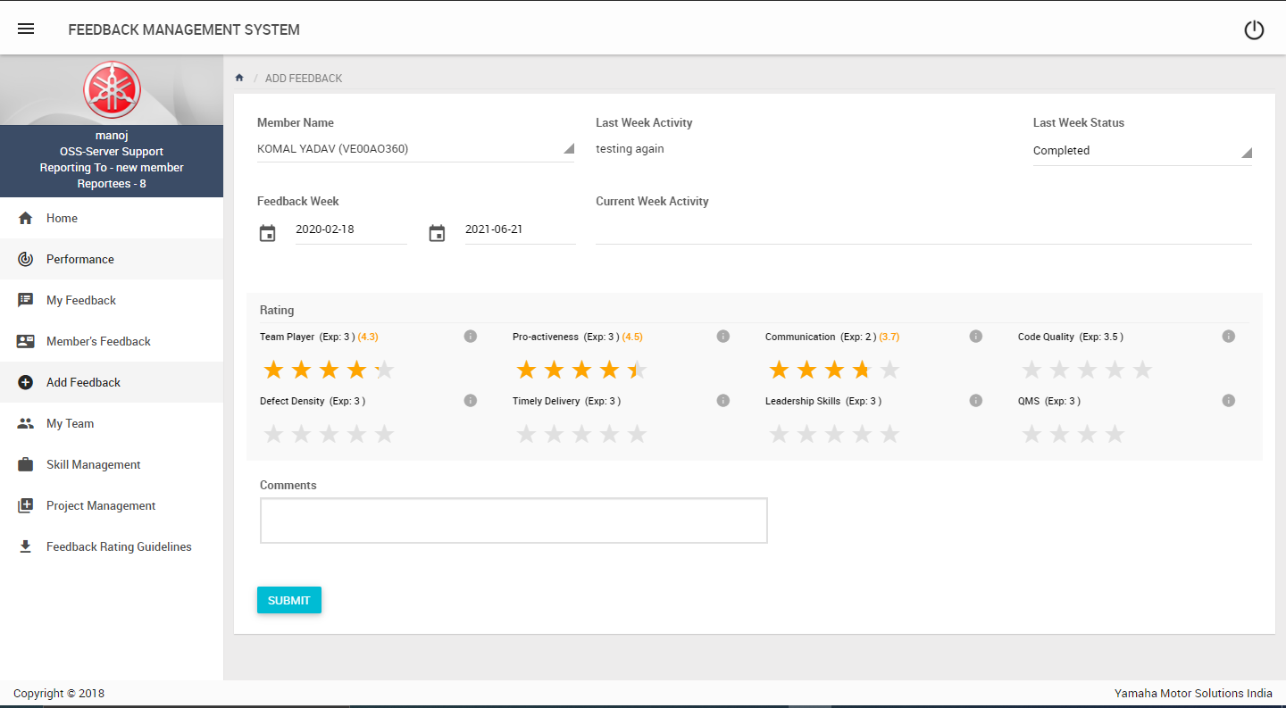
FEEDBACK MGMT. SYSTEM (OJT)
TEAM: TDML (12th Apr 2021 - Present)
CONTRIBUTIONS
Added APIs:
Email Reminder module
Team Summary module
Mail Notification Setting module
Modified APIs:
Add Feedback Module
Email Module
LEARNINGS
Requirement understanding and problem analysis.
Changed application to fetch configuration values from database.
Hands on Experience on jQuery.
Attention to details.
Enhanced UI of application
Enhanced Problem-solving skills and critical thinking.

Slide 11









OVERALL EXPERIENCE
CHALLENGES FACED
LEARNINGS
Requirement understanding and Problem analysis
Implementing theoretical concepts
Time management
Working with new technologies
Work culture and ethics s
tion.
Project design and documentation
ics
Various new tools and technologies
de
Coding Standards and writing optimized code

Slide 12
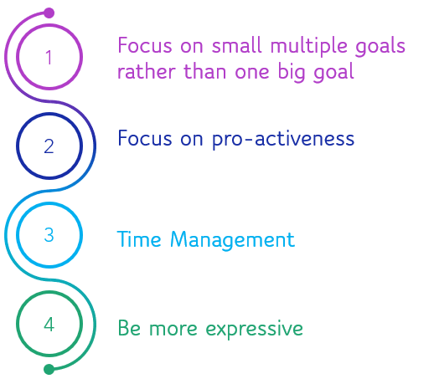

IMPROVEMENT POINTS

Slide 13
THANK YOU

